Slide 1
Fresh Grads – Group Project
WEB BASED PLACEMENT MANAGEMENT SYSTEM
Group Members:
HEMALATHA V, T030101004
N AKHILA, T030101006
S HARINI, T030101009
VIJITHA BEULAH RAJ, T030101012
TASNEEM BANO, T030101013

Slide 2
Problem Statement
The purpose of the project “WEB BASED PLACEMENT MANAGEMENT SYSTEM USING CERTIFICATE AUTHENTICATOR”, the manual work makes the process slow and other problems such as inconsistency and ambiguity on operations. In order to avoid this web-based placement managed system is proposed, where the student information in the college with regard to placement is managed efficiently. It intends to help fast in fast access procedures in placement related activities and ensures to maintain the details of the student. Students logging should be able to upload their personal and educational information. The key feature of this project is that it is one-time registration enabled. The placement cell calls the companies to select their students for jobs via the campus interview. The placement cell allows the companies to view the student resumes in selective manner. They can filter the students’ profile as per their requirement. The job details of the placed students will be provided by the administrator.

Slide 3
Road Map
Application will be developed in following Sprints –
POSTMAN->Spring REST Controller->
Service Layer->
Spring Data JPA Repository Layer->
Database

Slide 4
Plan
Design
    Generate the skeleton as per class design provided
TDD approach
    Identify test cases for each module
    Write Failing Test cases
    Convert the Test Cases in GREEN
Implement the case study in incremental manner

Slide 5
Modules
Login Module:
All university and corporate must login into the website to view student information, placement schedule information. All user names and password must be protected by using this module, which means that for each user, there must be unique username and password.
Student process module:
In this module,
University can post new student data by giving the following information,
Student name
Qualification
Course
Year of passing
Certificate
Corporate can download the certificate of a particular candidate by giving following information
Student name
Hal ticket number
Search module:
In this module corporate can search for candidate information. The search process is working based upon the search string, which is related to name or hall ticket number
Placement schedule module:
In this module corporate can schedule a campus placement in particular university by giving the following information
Schedule date
Qualification
Year

Slide 6
Class Design
College
POJO Classes:
1
-Id : long
-collegeAdmin : User
-collegeName : String
-location : String
Student
1
-id : long
-name : String
-college : College
-roll : long
-qualification : String
-course : String
-year : int
-certificate : Certificate
-hallTicketNo : long
*
1
1
*
Certificate
1
-id : long
-year : int
-college : College
1
Placement
-id : long
-name : String
-college : College
-date : LocalDate
-qualification : String
-year : int
*
1
User
-id : long
-name : String
-type : String
-password : String
Admin
1
-id : long
-name : String
-password: String
1

Slide 7

Use case Diagrams
Add student data
Upload Certificate
Login/Register
University/College
Schedule Placement Drive
Use case diagram for Corporate
Search Students
Update Student Data
Search Student
Login/ Register
View Certificate
Use case diagram for University/Colleges
Corporate
Search for College/University

Slide 8

Use case Diagrams
View Pending Corporate Registration Requests
Login/ Register
Approve/Reject Request
Admin
View Pending University Registration Requests
Approve/Reject Request
Use case diagram for Admin

Slide 9
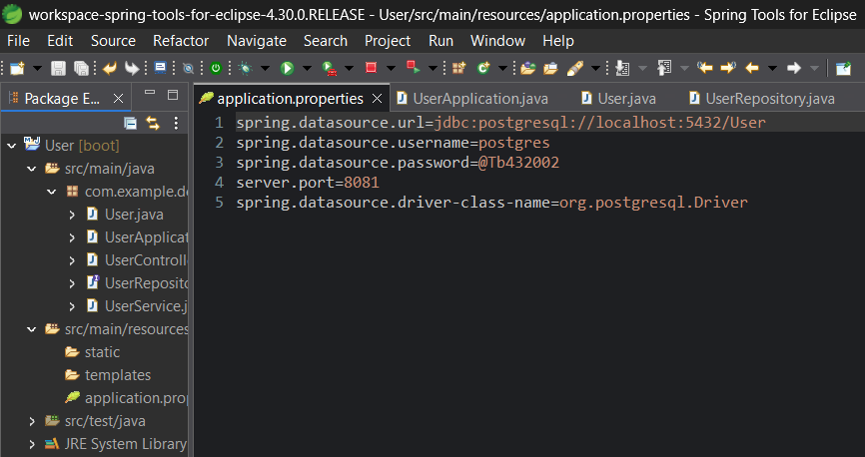
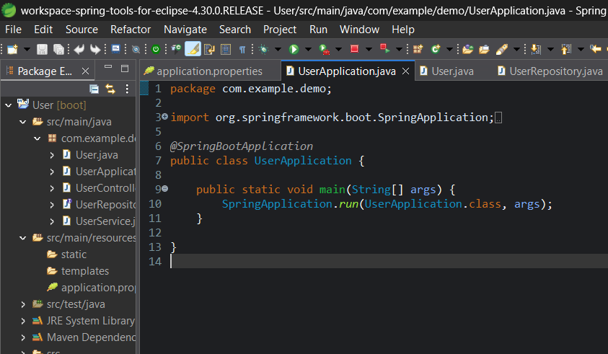
USER ENTITY (Application)

Slide 10
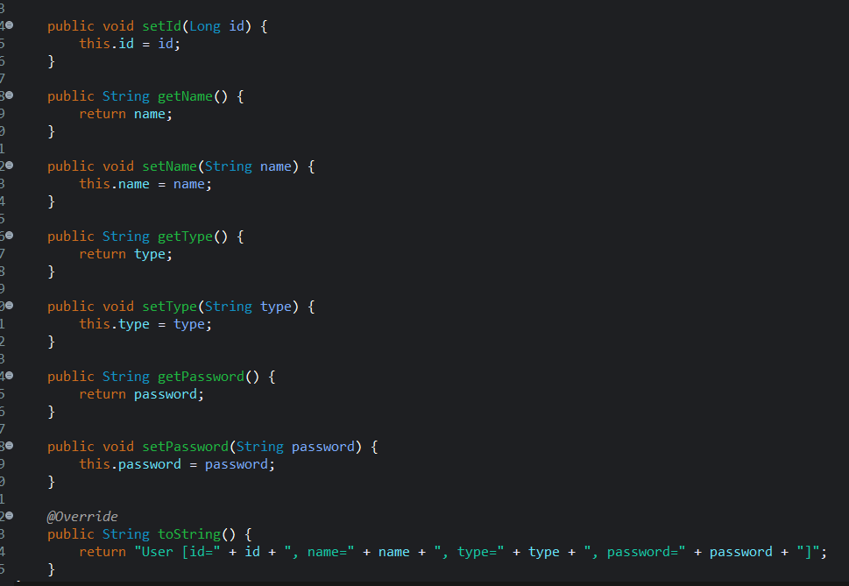
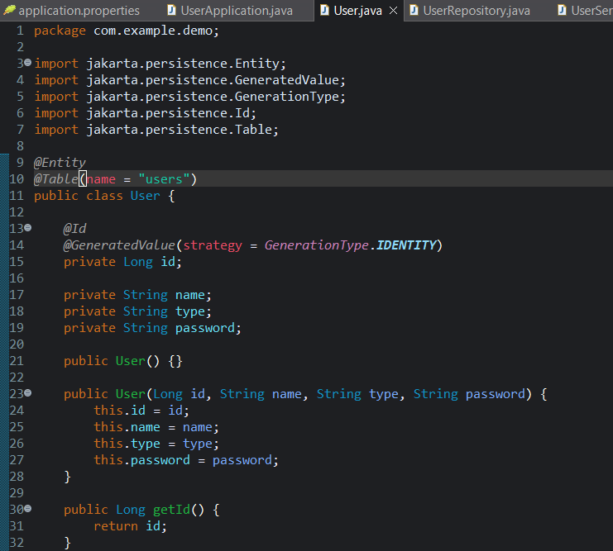
USER ENTITY

Slide 11
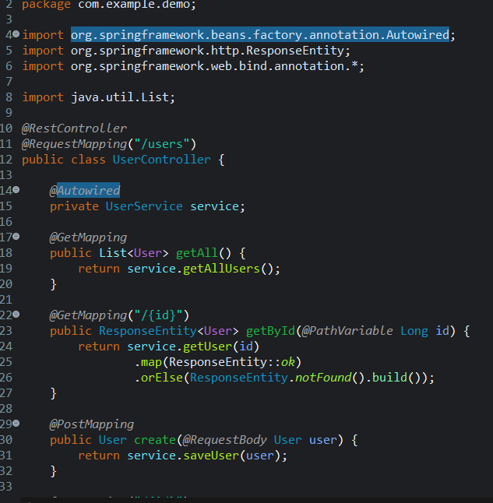
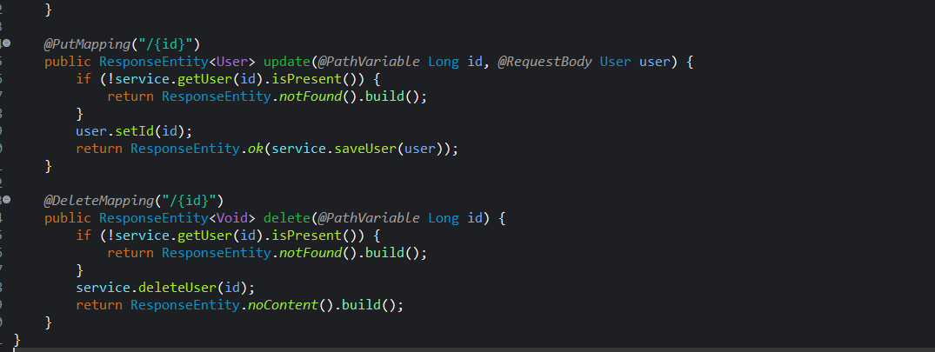
USER ENTITY (Controller)

Slide 12
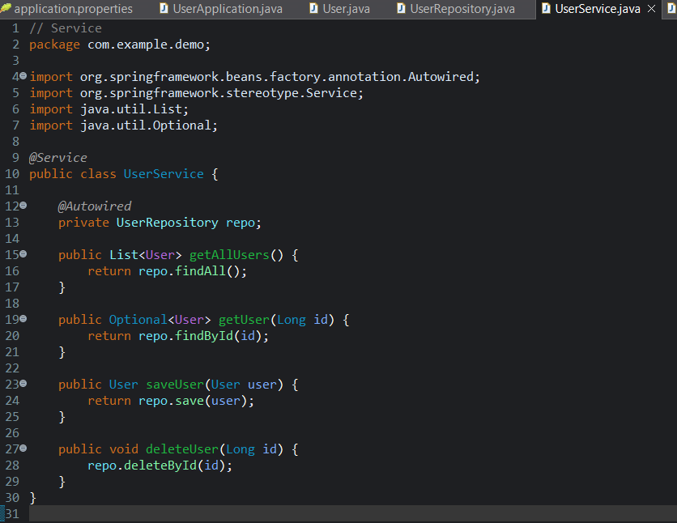
USER ENTITY (Service)

Slide 13
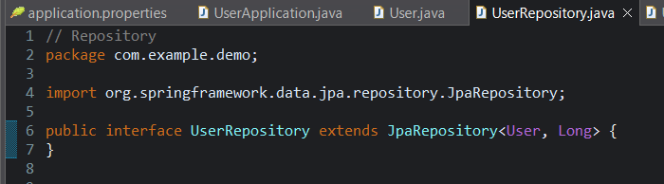
USER ENTITY
(Repository)

Slide 14
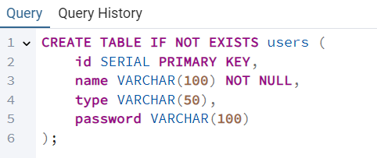
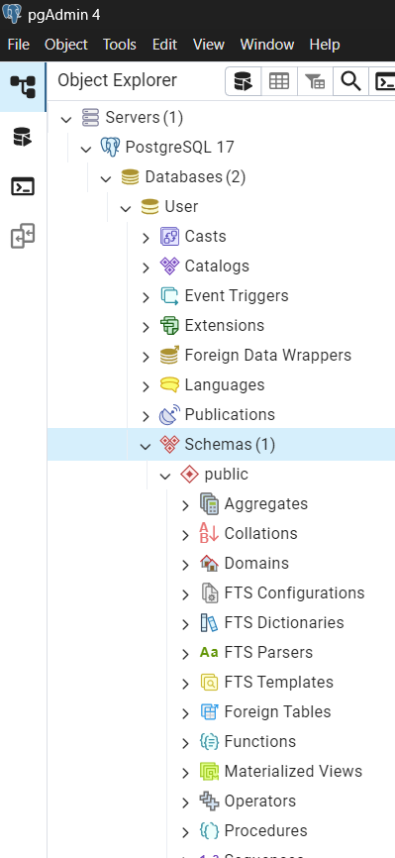
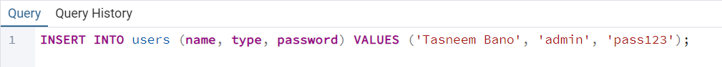
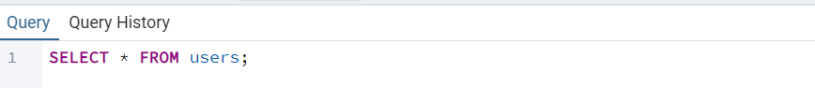
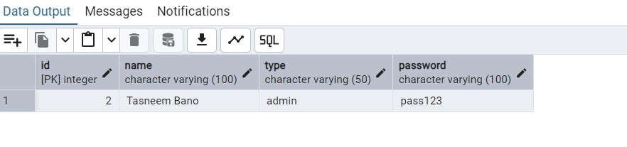
Database
(PostgreSQL)

Slide 15
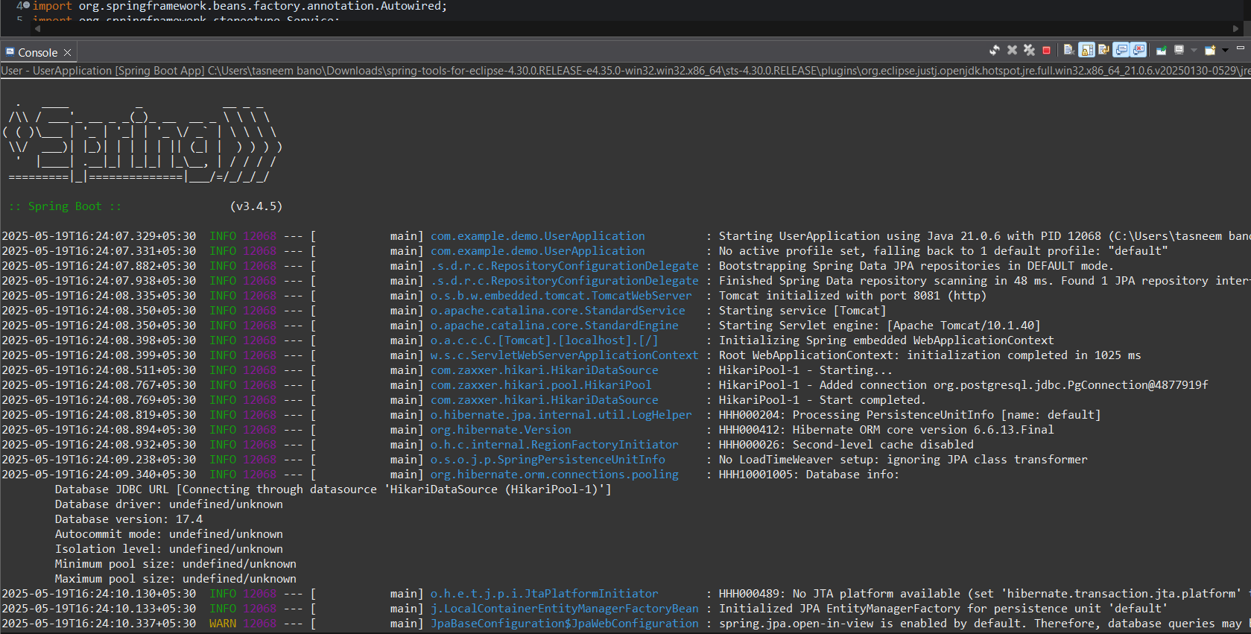
(After Execution)

Slide 16
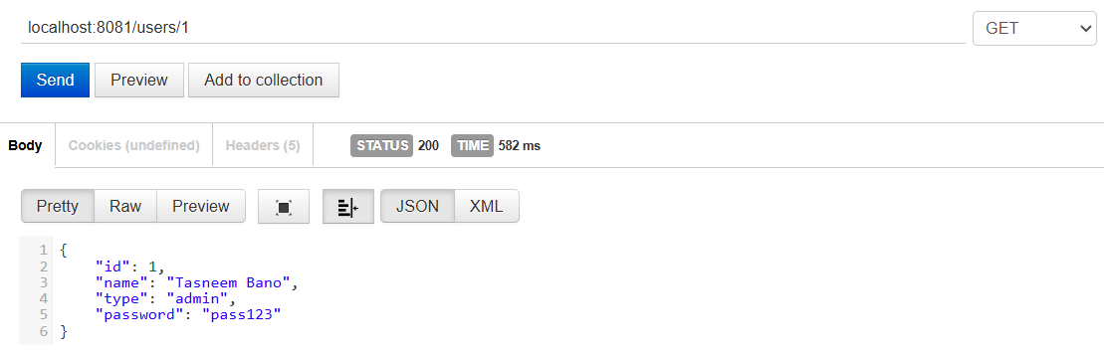
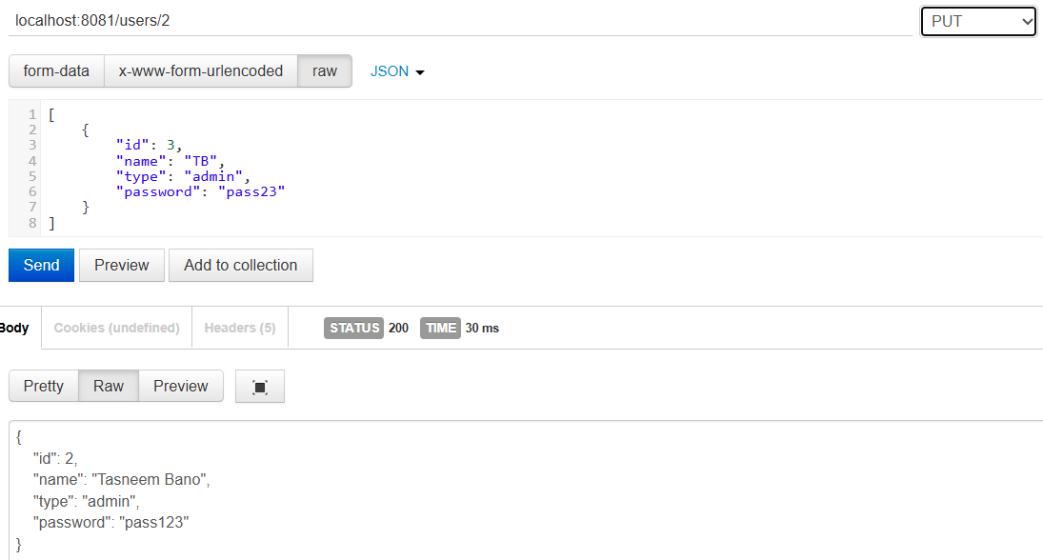
Testing Spring Boot CRUD APIs
(Tabbed Postman- GET,POST,PUT,DELETE)

Slide 17
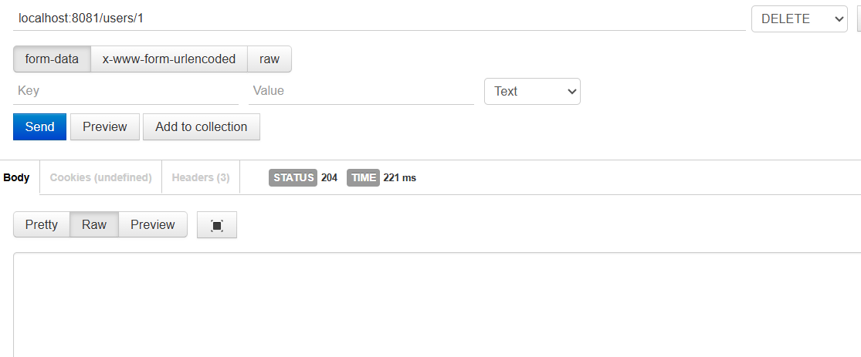
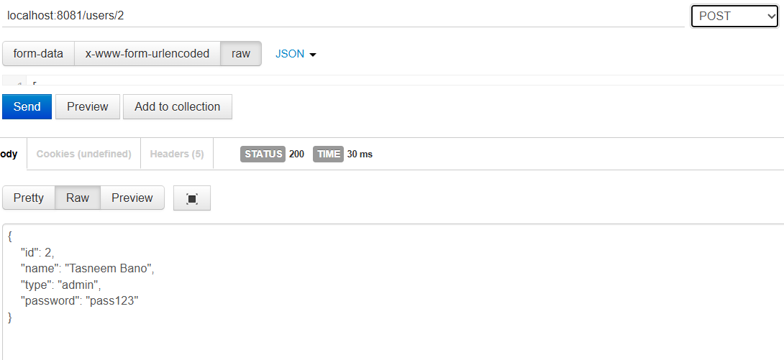

Slide 18
